Slide 1

Basic Bitcoin Tech: Timechain Explorers
Host - Simplest Bitcoin Book w/ Portland.HODL

Slide 2
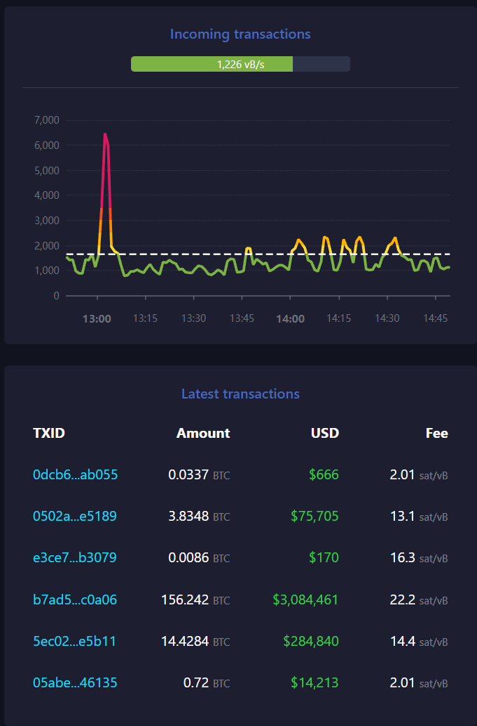
Overview -
Topics
What does a timechain explorer do?
Ways to utilize these explorers.
Types of timechain explorers.
Hosted
Self Hosted
Privacy.

Slide 3
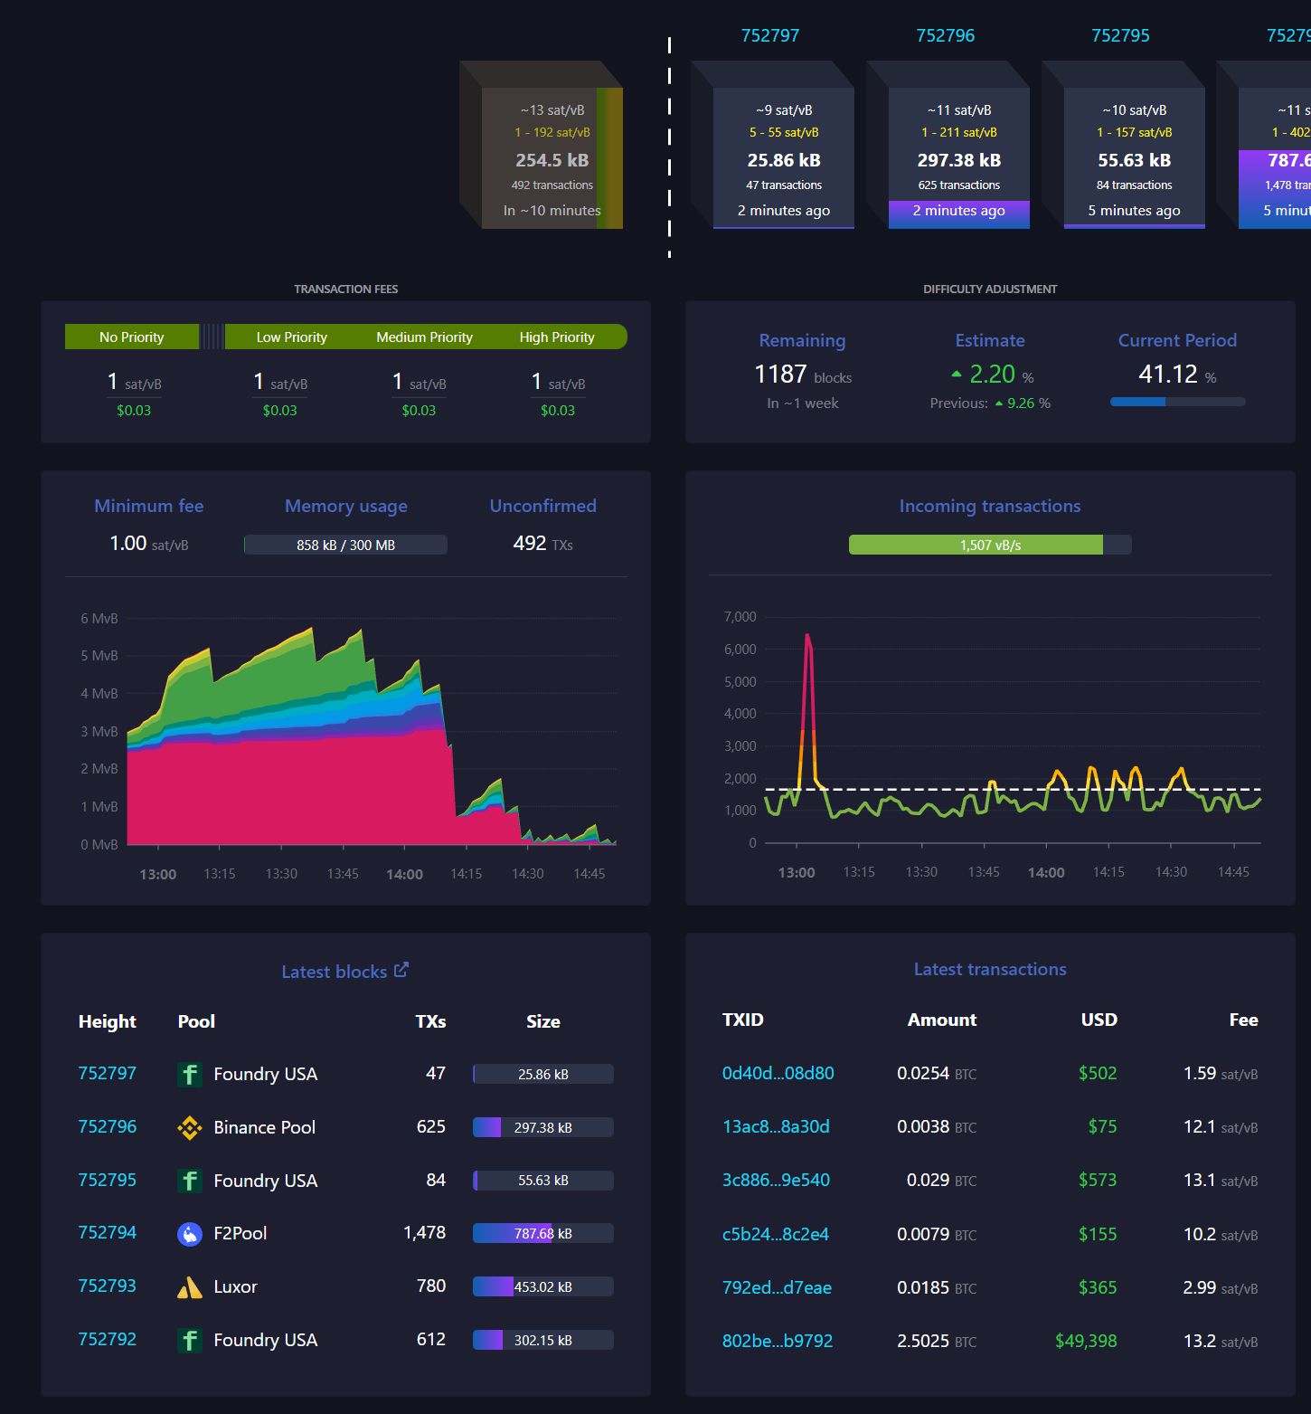
What does a timechain explorer do?
Definition:
“A software for visualizing blocks, transactions, and blockchain network metrics (e.g., average transaction fees, hashrates, block size, block difficulty)” - nist.gov
Notes:
Timechain explorers are just database browsers and visualizers.
There are numerous explorers available to use each with their own strong points.
https://mempool.space showing various statistics regarding the timechain

Slide 4
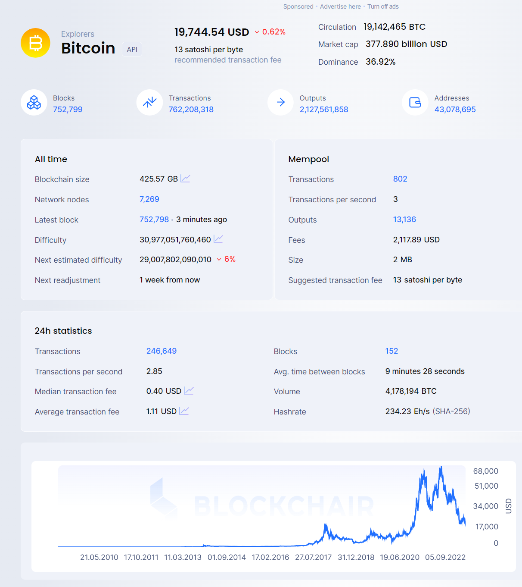
Ways to use timechain explorers.
To view pending transactions.
To check the balances of addresses.
Monitor incoming blocks.
Fee estimation.
Current mempool size
Chainalysis
Blockchair.com statistics

Slide 5
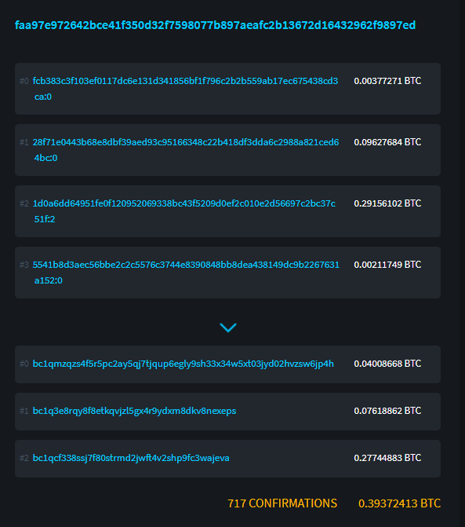
Getting the status of a transaction?
If you are ever wondering what the status of a transaction is then you can type the ‘TXID’ into one of these explorers and it will return many of the most important pieces of information such as …
Pending or confirmed.
Amount of bitcoin transacted.
The address those bitcoins went to.
An example of a transactions inputs and outputs as seen on the blockstream block explorer.

Slide 6
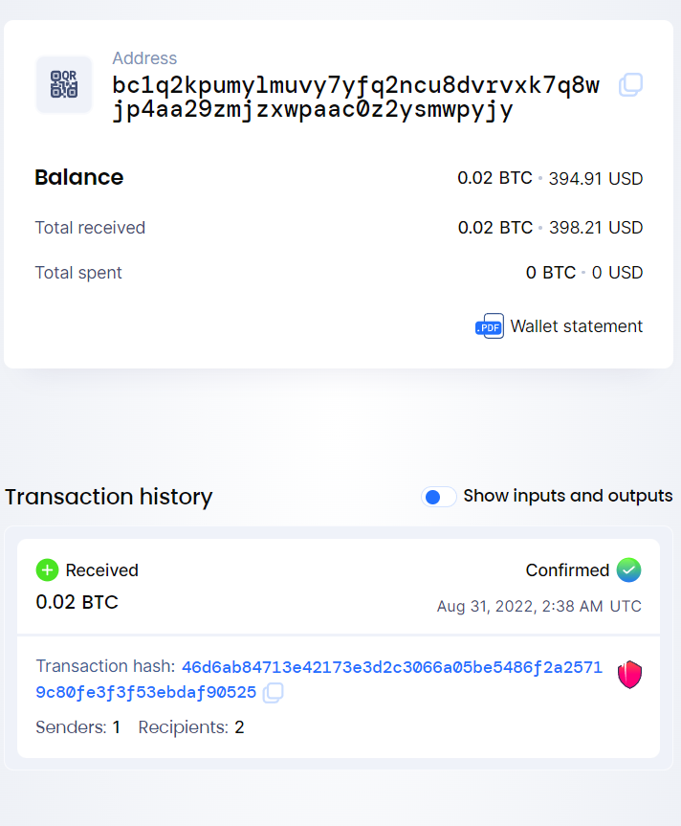
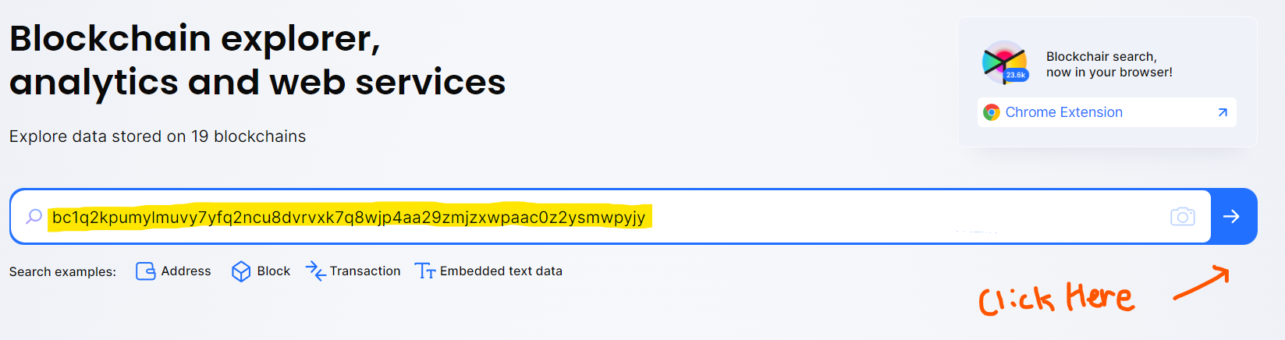
Viewing the balance of an address
Copy the address you want to view
Paste it into the seachbar of a timechain explorer
Tap/Click the search icon
A bitcoin address and the transactions associated with it.

Slide 7
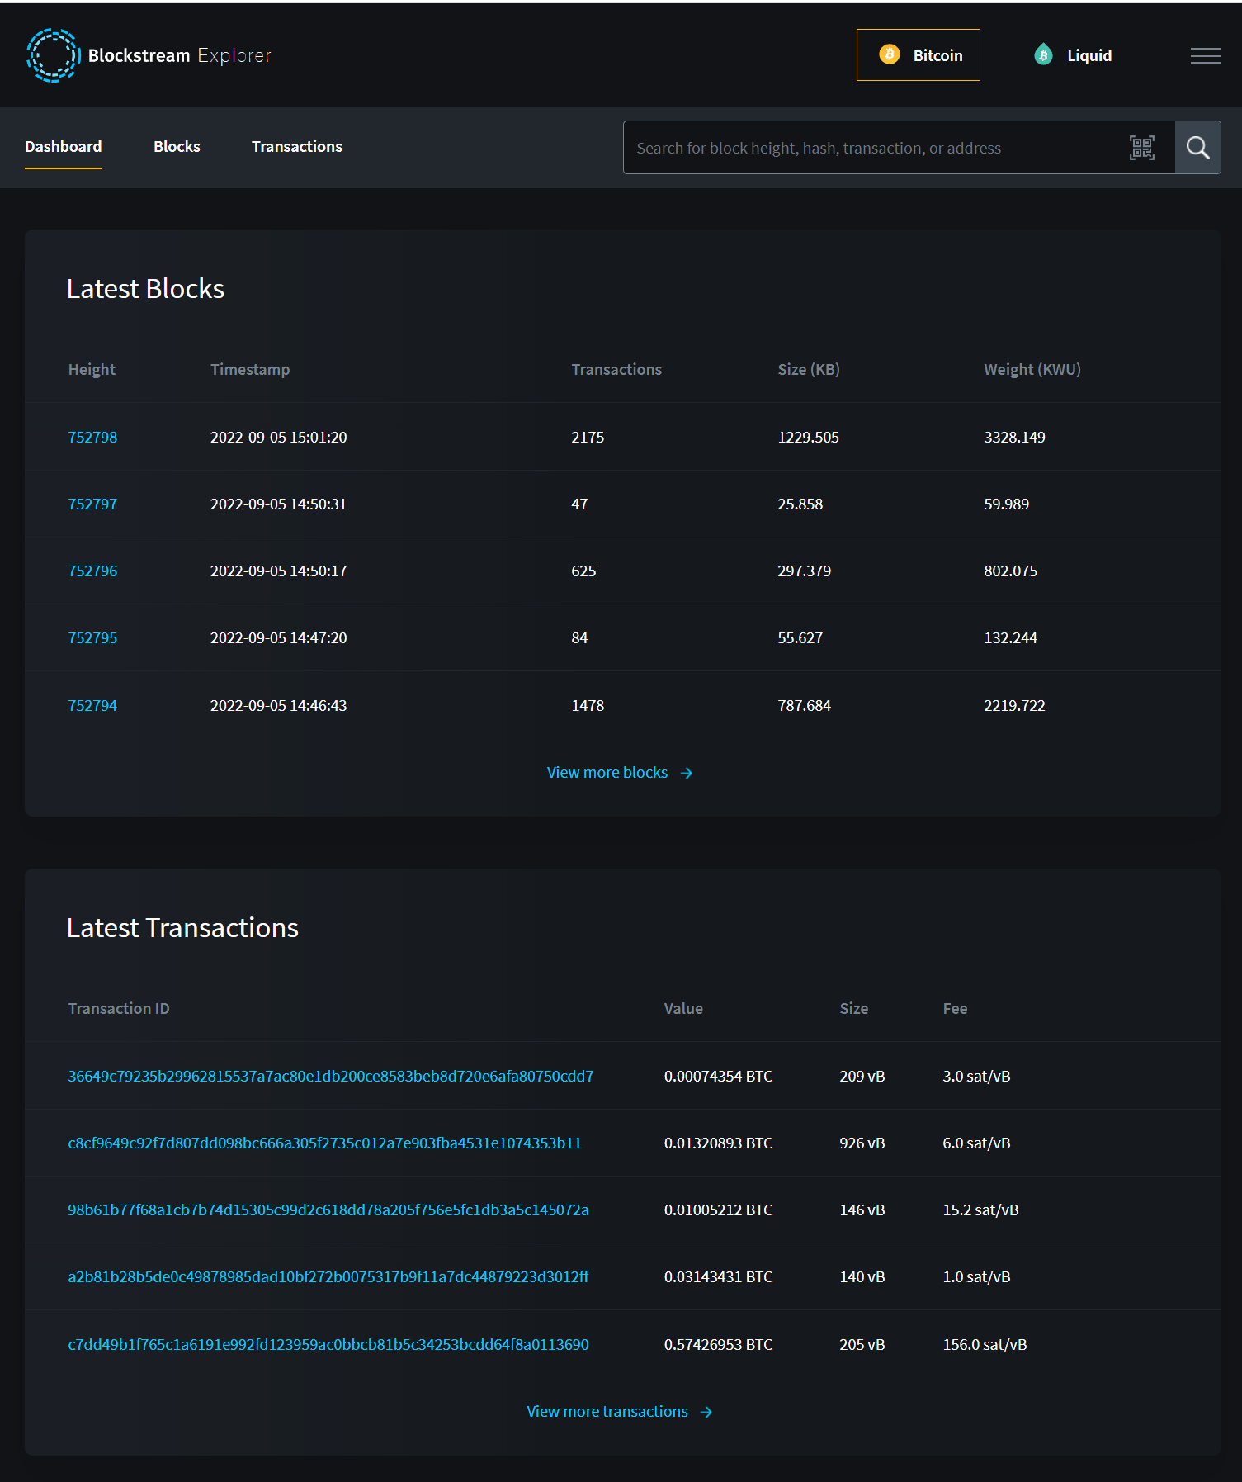
Types of timechain explorers - Hosted
Hosted Explorers - These are explorers that aren’t contained on your own network and as such pose privacy concerns.
https://mempool.space/
https://blockstream.info/
https://blockchair.com/
https://www.blockchain.com/
https://btcscan.org/
These timechain explorers can collect information such as IP Address, Terms you have searched for such as addresses and TXID’s, and the times these events are occuring. This isn’t inherently bad but does pose a privacy risk.
There is also a risk that the node these services operate on may not be up to date or information may be manipulated.
The Blocksteam Explorer is a hosted service.

Slide 8
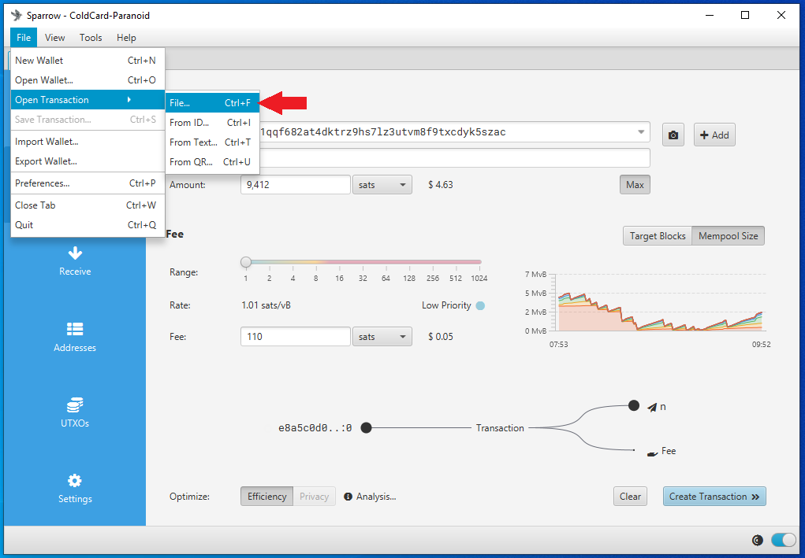
Types of timechain explorers - Self Hosted
Self Hosted Solutions - These are blockchain explorers that run on top of your Bitcoin Core node. As such the contents become trustless and privacy concerns are mitigated since all information stays on the your local network.
https://github.com/janoside/btc-rpc-explorer
https://github.com/mempool/mempool (mempool.space)
Sparrow + Electrum Personal Server
These solutions are harder to implement but provide a huge payoff for privacy, accuracy, and sovereignty.
Sparrow wallet showing transaction details.

Slide 9
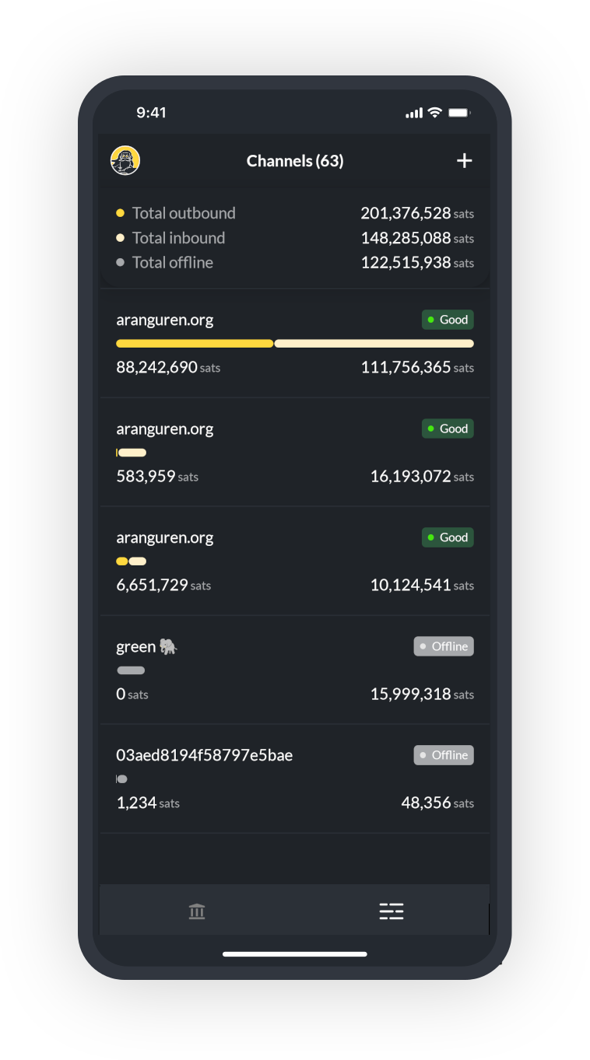
Privacy.
If you don’t want anyone to know what addresses or transactions you have taken interest and checked the details of don’t use websites. Use a self hosted solution that runs on top of your node.
Using web services isn’t inherently bad because they are incredibly convenient to use in a pinch.
Almost all mobile wallets will connect to a hosted timechain explorer service to get the information of addresses and transactions. This is because mobile wallets don’t have the space to hold the entire timechain.
There are mobile wallets that can connect to your node to provide additional privacy. ‘ZEUS’

Slide 10
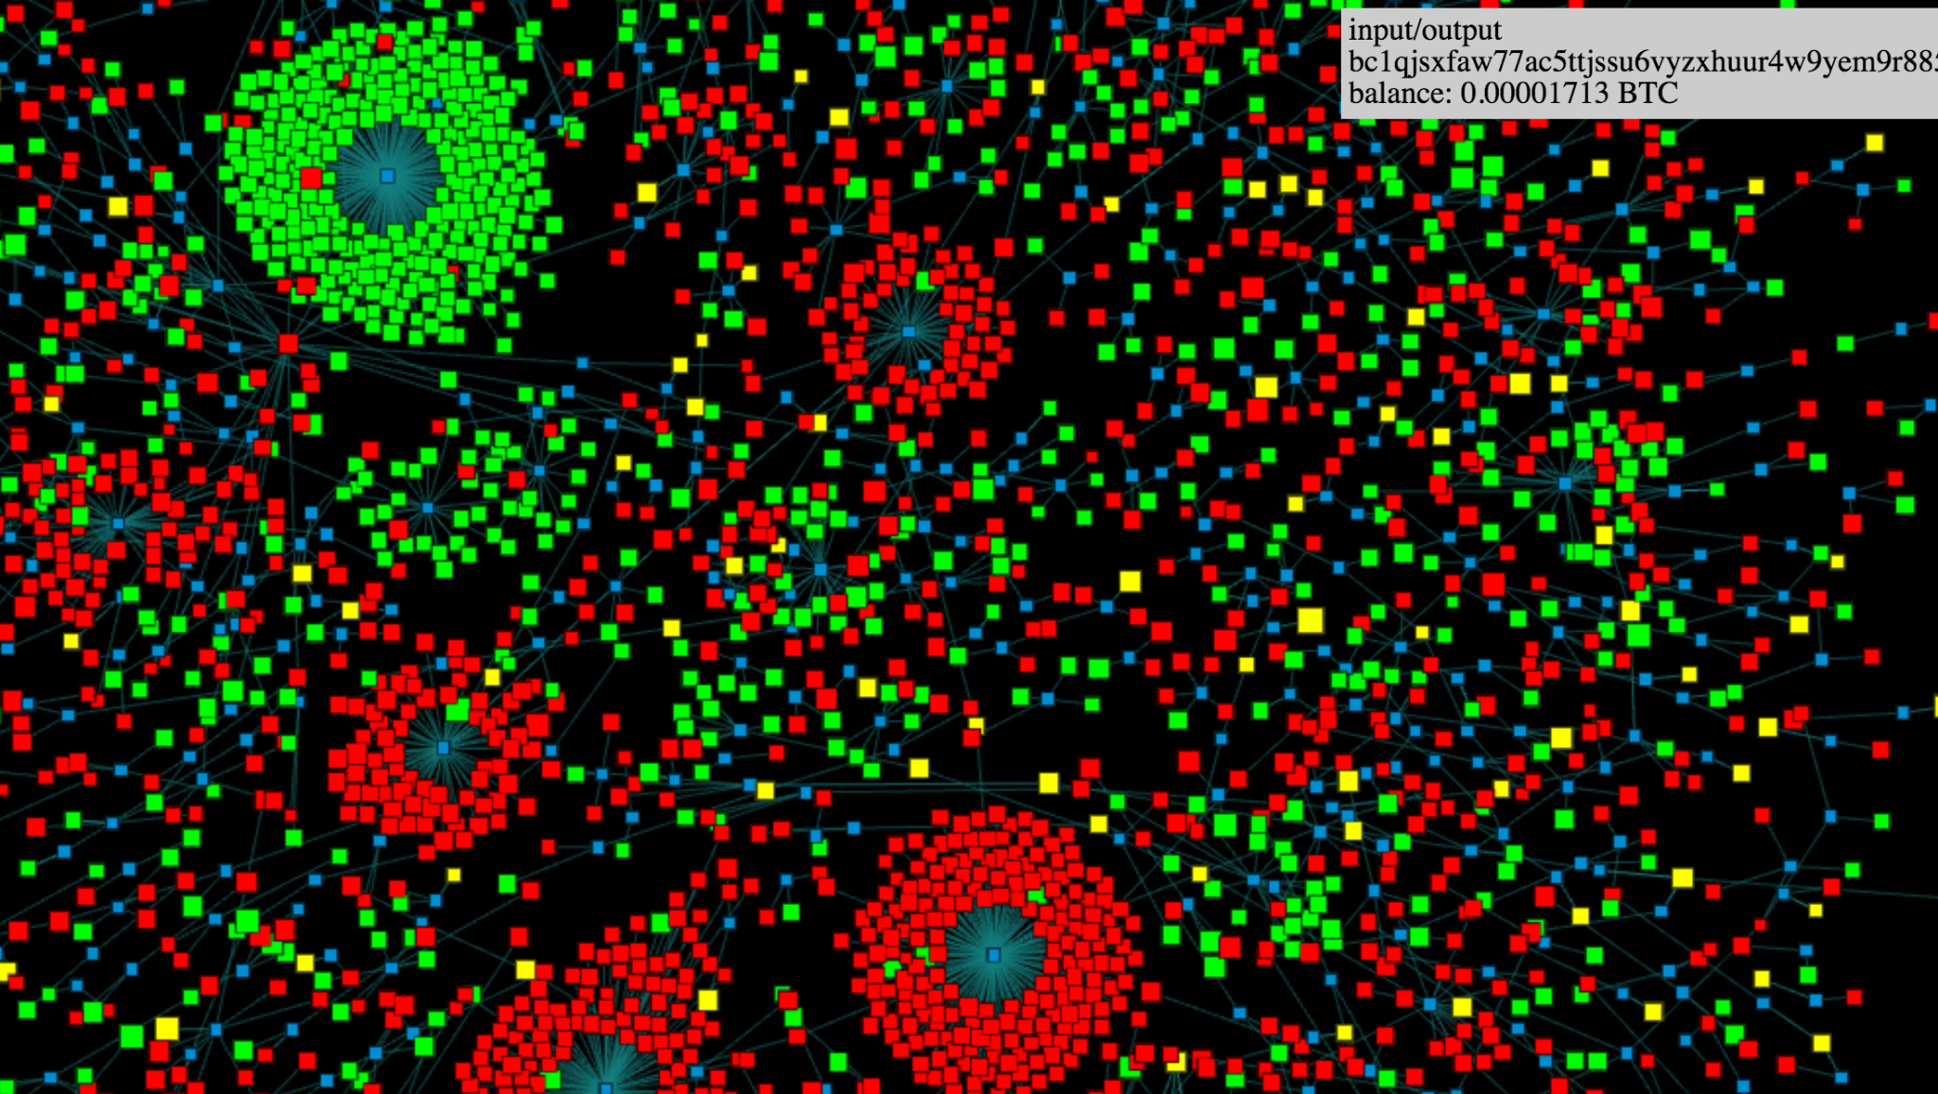
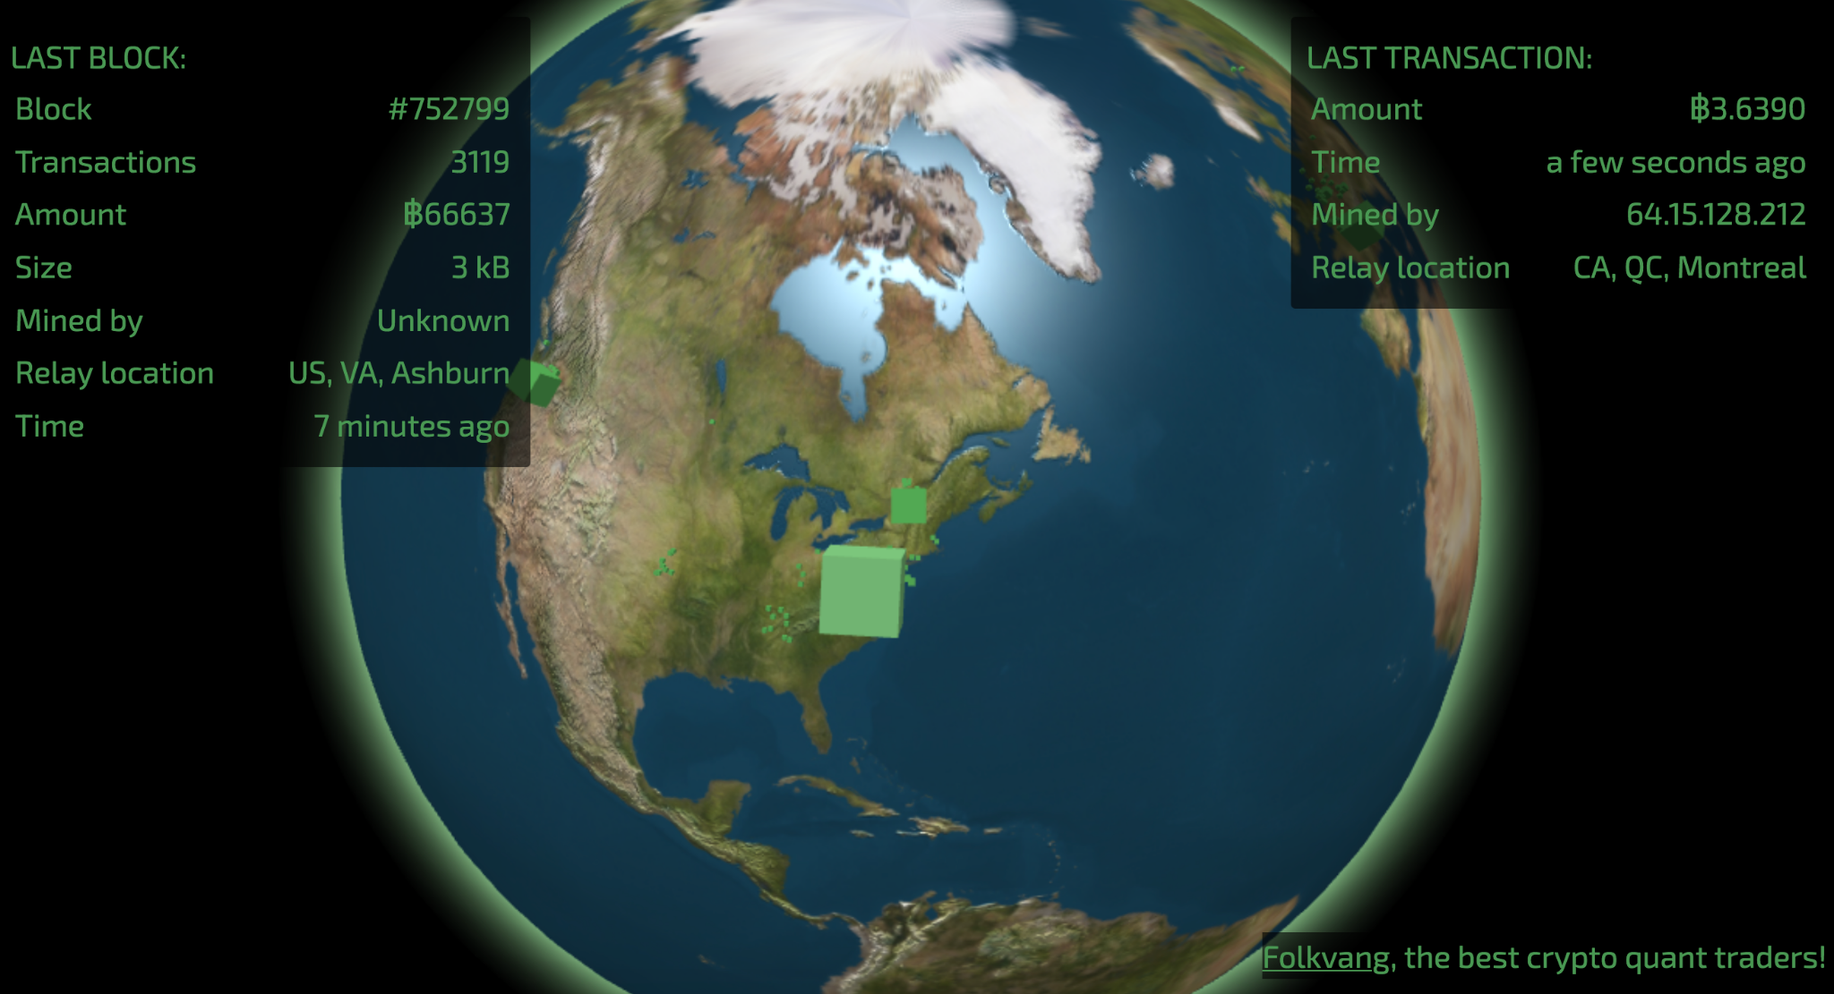
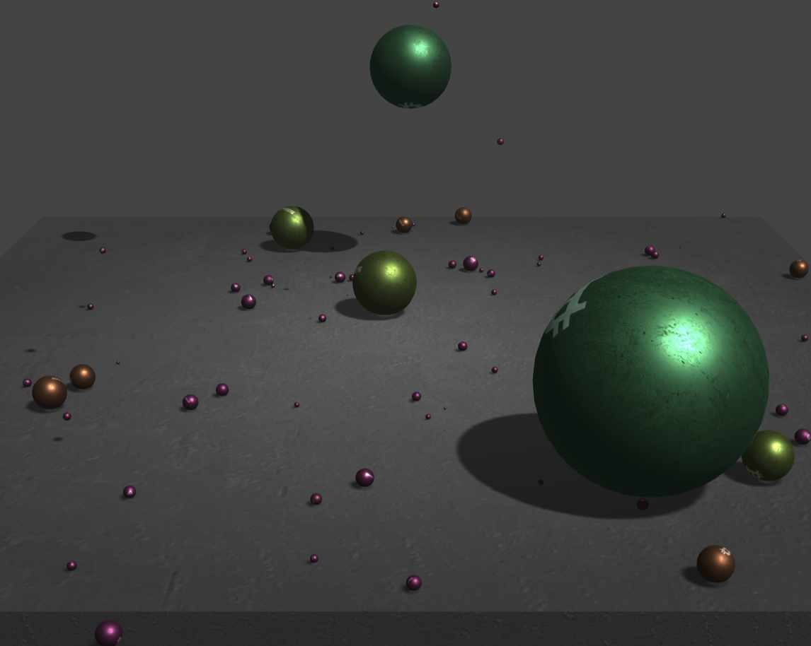
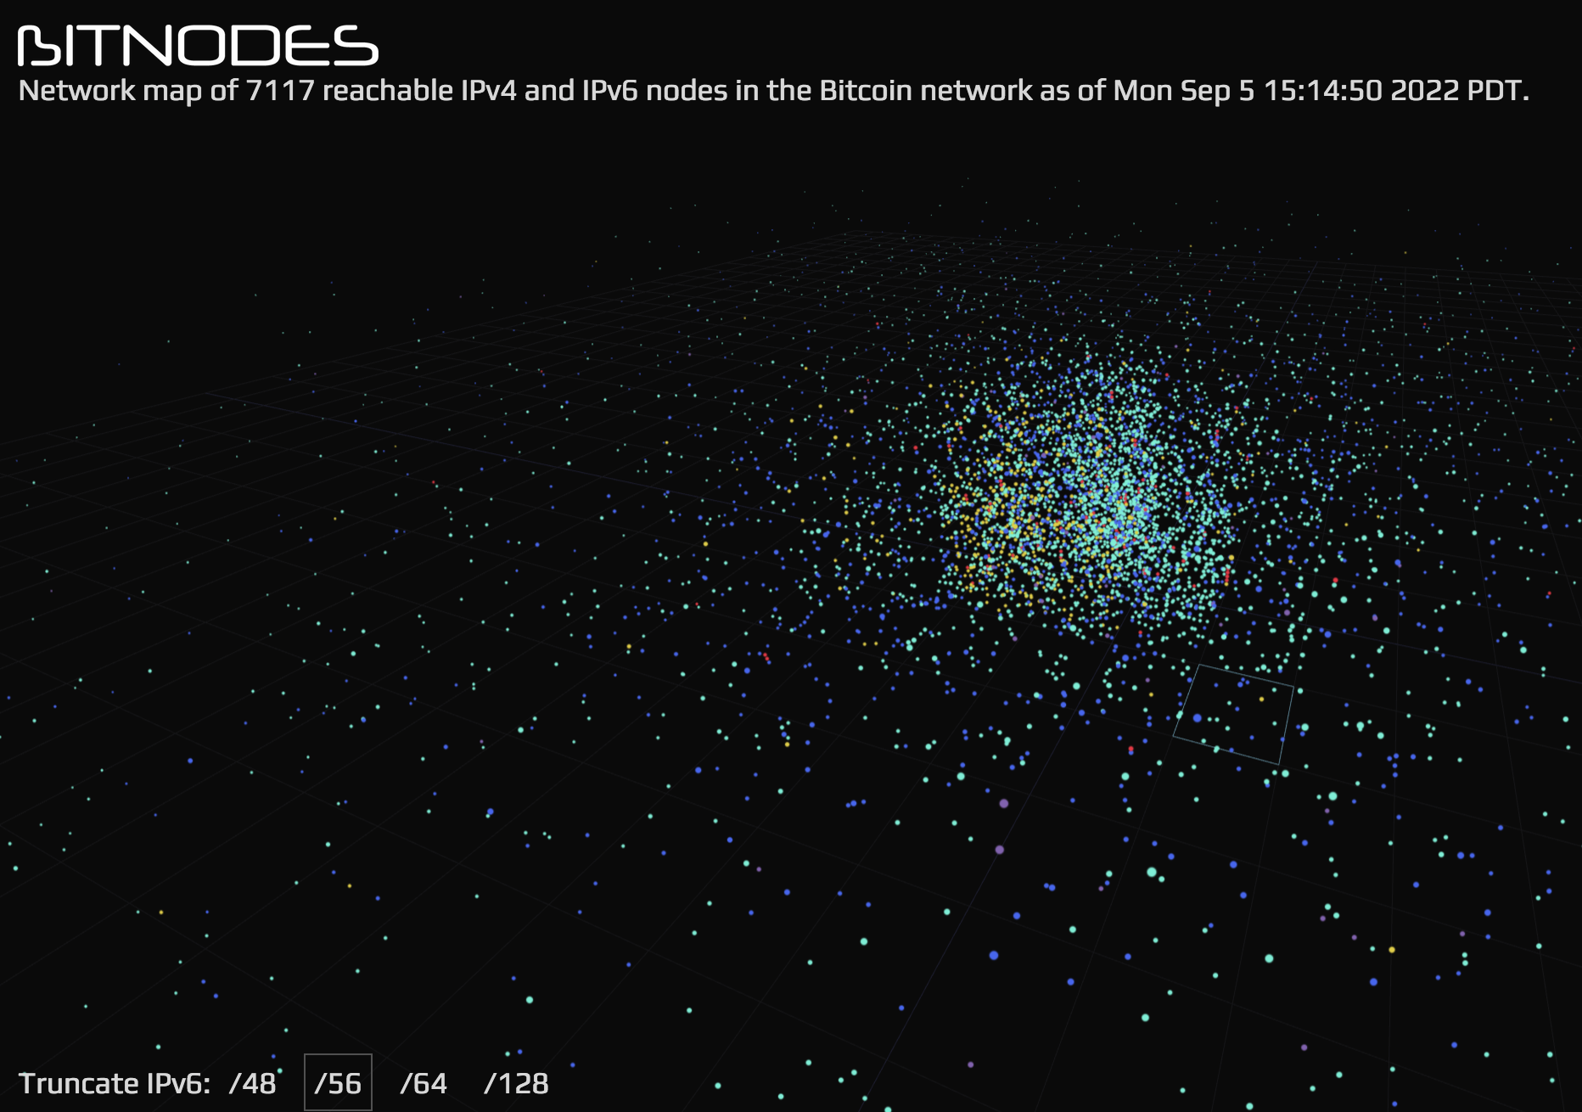
Some fun visualizers
Here are some super fun visualizers for exploring the Bitcoin network:
https://dailyblockchain.github.io/
https://blocks.wizb.it/#
https://privacypros.io/tools/bitbonkers/
https://bitnodes.io/nodes/network-map/

Slide 11
Thanks For Listening.
Questions or Comments? Please ask to come on stage.
Anything incorrect please comment on the slide in question.

